Slide 1
Influence Model – Guidance and Template
Capability Building

Slide 2
Influence Model (Communications)
Template
“I will change my own behaviour if…”
Role-modeling
Fostering conviction and understanding
Component actions…
Component actions…
“I see superiors, peers and subordinates behaving in the new way”
“I know what is expected of me – I agree with it, and it is meaningful”
Mindset & behaviour shifts
Component actions…
Component actions…
“ I find it easy - the structures, processes and systems align with the new way”
“I have the skills and competencies to behave in the new way”
Developing talent and skills
Reinforcing with formal mechanisms

Slide 3
Influence Model (Working)
Template
New behaviour to be embedded | …
Who needs to behave in this way?
What steps can you take to achieve the desired behaviour/ mindset/ routine change? Consider steps and/or from:to for each element
Fostering understanding and conviction “I know what is expected of me – I agree with it and it is meaningful”
Role-modelling “I see superiors, peers and subordinates behaving in the new way”
Developing talent and skills “I have the skills and competencies to behave in the new way”
Reinforcing with formal mechanisms “The structures, processes and systems reinforce the change in behaviour I am being asked to make”

Slide 4
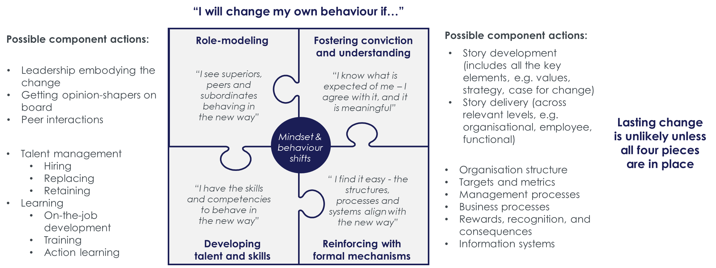
How to use the Influence Model
What is this tool?
The Influence Model is framework to help you think about how plans and recommendations can move from strategy to implementation. The tool consists of four levers which should be considered when attempting to shift mindsets and behaviours.
PowerPoint instructions
Either copy across the influence model template to your own presentation or type directly into this one
To add text to the communications template, click on “Component Actions…” bullet. Your cursor will appear, allowing you to delete the existing text and add your own thoughts
When to use this tool? One of the biggest challenges of improvement projects is turning plans into action. In almost all instances a project’s success is dependent on multiple people altering their behaviour/ mindset, supporting people to think or act in the new way is therefore crucial to achieving the desired change. The influence model should be used when conducting any improvement project that involves people amending their behaviour in some way.
Find more tools and templates at:
thepsc.co.uk/capability-building/

